Slide 1


Slide 2
Band Members
Amit Verma
Developer (Muni)
Taulbee Davis
Internal Tool Team
Randy Raypole
Release Engineer

Slide 3
“These aren’t the priorities that we came up with the other day in our client request meeting…. Will and Anthony are going to shoot me”

Slide 4
Problem Statement
Muni program have come up with an elaborate scoring algorithm for prioritizing client requests. It takes into account ~12+ criteria for scoring client requests, which probably isn’t conducive for JIRA. We are currently using excel
The problem is that we have to manually ensure that JIRA and excel scoring sheet are in sync with each other

Slide 5
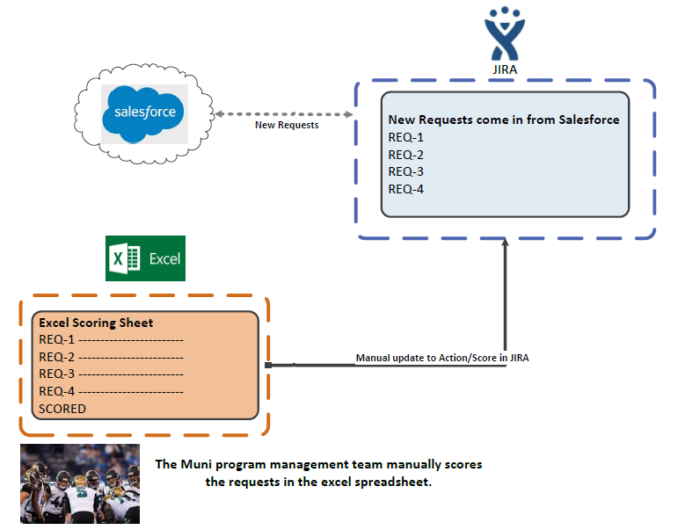

Slide 6
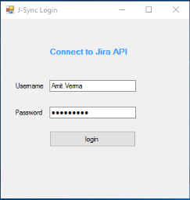
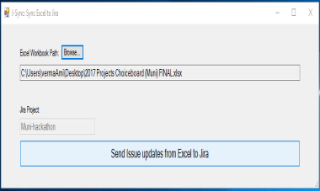
Solution
C# application
Reads the score and action from Excel
Using the JIRA API – updates the matching JIRA work item
Reduces manual work

Slide 7
Demo

Slide 8
Questions?

